Slide 1
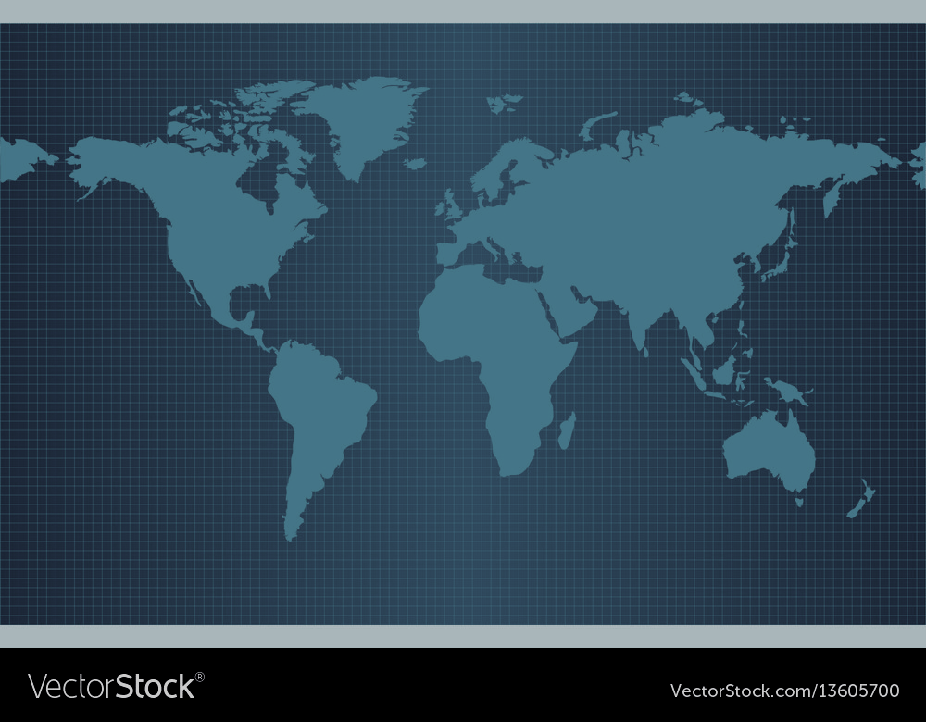

Investment opportunities in New Age India for NRIs
Series of Financial awareness webinars exclusive for Singapore NRIs

Slide 2

Current Indian investing landscape
Investment opportunities in New Age India

Slide 3

Current Indian investing landscape
The India Growth Story
  India – Q1 (June 2023) – 7.8%, Q2 (Sep. 2023) – 7.6%,
  Q3 (Dec. 2023) – 8.4%)
  2023
  Singapore China US
  1.2% 4.2% 1.5%
  Fastest growing economy in top 20 economics of the world.
  India in an “Amrit Kaal” movement from 75th year to 100th year of it’s independence. Journey of becoming a Developed economy from Developing Economy.
Investment opportunities in New Age India

Slide 4
Current Indian investing landscape
Democratic governance
  Strong and stable government.
  Constructive tax reforms (Direct & Indirect Taxes IBC) and business oriented policy framework.
  Transparency and efficiency of capital markets.
  Independence and productivity of public sector.
  Quality of regulator for Banking (RBI) Capital Markets (SEBI) and Insurance (IRDA).
  Independence of Judiciary.
Investment opportunities in New Age India

Slide 5
Current Indian investing landscape
Geopolitical might
  Diplomatically connected, yet not aligned to powers.
  Strategical positioning for own economic interests.
Infrastructure buildup
  Country wide development with billions of dollars of investments into railway, road network and aviation.
Make in India, Make for the World - return of manufacturing to India
  Offshoring gains – Shifting of manufacturing from China (China + 1 strategy).
  Inclusive growth creation of blue collar jobs.
  Indian exports crossing US$ 450 billion.
  Robust capex cycle by private sector.
Investment opportunities in New Age India

Slide 6
Current Indian investing landscape
Demographic dividend
  Population of nearly 1.5 bn with 47% under the age of 25!
  Largest young workforce – English speaking, skilled and well educated.
Consumption boost
  Fastest growing consumer market in the world with $2000+ per capita income.
  Major shift from unorganized to organized players.
Digitization and financialization of the economy.
  Highest number of UPI transactions and second highest internet user base in the world.
  Domestic financialization overshadowing foreign inflows.
Investment opportunities in New Age India

Slide 7
Current Indian investing landscape
What can go wrong for India ?
Government not getting elected with strong majority
Slim chance
Deep institutional frame work in place
Present leadership not in power on account of age, health, etc.
Bar of expectations raised too high.
Changes not easily reversible.
3. High valuations of Indian Stock Market & Real Estate
Growth markets command premiums.
Averaging of cost by making investments in a calibrated matter over a period of time.
Investment opportunities in New Age India

Slide 8
Current Indian investing landscape
What can go wrong for India ?
4. Corporate governance
Strong regulations.
Availability of information & research.
5. Depreciation of the Indian Rupee
Very calibrated depreciation in last 10 years.
Depreciation in future expected to be quite limited
- chances of appreciation.
Investment opportunities in New Age India

Slide 9
Current Indian investing landscape
Depreciation of INR against the foreign currencies in the times to come
2.77% depreciation CAGR in 7 years
(Change from 31-12-2016 to 10-03-2024)
Activity | 2016 | 2017 | 2018 | 2019 | 2020 | 2021 | 2022 | 2023 | 10 Mar 2024 | CAGR till date
1 USD TO INR | 67.96 | 63.84 | 69.57 | 71.36 | 73.05 | 74.49 | 82.75 | 83.19 | 82.74 | 2.77%
1 SGD TO INR | 46.92 | 47.73 | 51.04 | 53.03 | 55.26 | 55.18 | 61.72 | 63.02 | 62.13 | 3.98%
Source - https://in.investing.com/currencies/sgd-inr-historical-data?end_date=1710477750&st_date=1455388200
Depreciation of currency on account of two factors:
  Foreign fund inflows and outflows.
  Inflation differential between the two economies.
Foreign fund flows beginning to improve through FII financial investments as well as FDI structured investments in India.
Investment opportunities in New Age India

Slide 10
Current Indian investing landscape
Depreciation of INR against the foreign currencies in the times to come
Comparison of Inflation in major economies globally
Activity | 2019 | 2020 | 2021 | 2022 | 2023
United States | 1.80% | 1.30% | 4.70% | 8.00% | 4.10%
United Kingdom | 1.80% | 0.90% | 2.60% | 9.10% | 7.70%
Canada | 1.90% | 0.70% | 3.40% | 6.80% | 3.60%
Australia | 1.60% | 0.90% | 2.80% | 6.60% | 5.80%
Singapore | 0.60% | -0.20% | 2.30% | 6.10% | 5.50%
India | 4.80% | 6.20% | 5.50% | 6.70% | 5.50%
https://www.imf.org/en/Countries
Investment opportunities in New Age India

Slide 11
Current Indian investing landscape
Stock market performance of top 20 economies of the world
(Change from 10–03–2023 to 10–03–2024 – last one year)
Country | Growth Rate
Russia – MOEX | 45.66%
Japan - NIKKEI 225 | 41.02%
USA - S&P 500 | 32.68%
USA - NASDAQ 100 - 52.31%
India – Sensex | 25.34%
Nifty Midcap 100 - 59.41%
Nifty Smallcap 250 - 62.45%
Brazil – BOVESPA | 22.63%
Italy - FTSE MIB | 22.44%
Saudi Arabia Tadawul All Share | 20.60%
Country | Growth Rate
Netherland - AEX | 16.01%
Germany – DAX | 15.47%
South Korea – KOSPI | 11.93%
France – CAC | 11.18%
Spain - IBEX 35 | 10.99%
Canada - S&P/TSX | 9.92%
Australia - S&P/ASX 200 | 9.83%
Indonesia - IDX Composite | 9.30%
Switzerland – SMI | 8.19%
Singapore STI | -0.95%
UK - FTSE 100 | -1.14%
China Shanghai Composite | -5.70%
Investment opportunities in New Age India

Slide 12
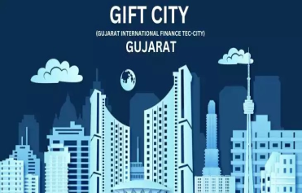
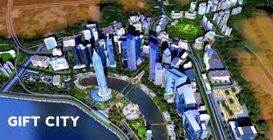

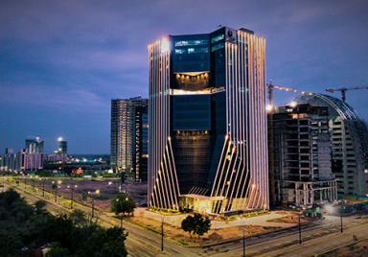
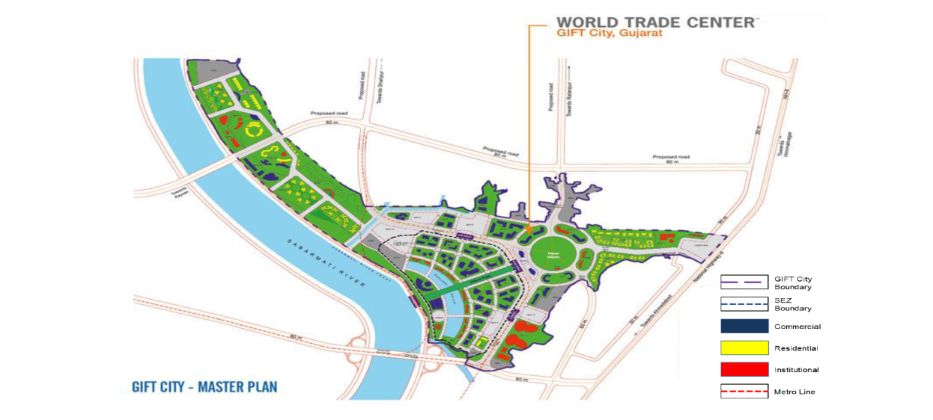

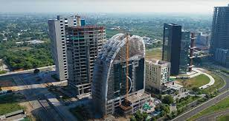
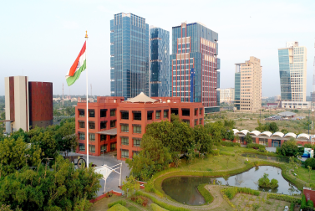

Current Indian investing landscape
Opportunities for NRI in Gift City
Gift City, Gujarat has been notified as India’s 1st International Financial Service Center (IFSC)
Investment opportunities in New Age India

Slide 13
Current Indian investing landscape
Opportunities for NRI in Gift City
Under Foreign Exchange Management Act, (International Financial Services Center), Regulations, 2015 :
  1. a unit setup in the IFSC is a person resident outside of India.
  shall conduct business in foreign currency.
  is not subject to Indian FEMA regulations
All other laws of India are applicable :
  Indian Income Tax Act – all units are person resident in India, exemption available under specific provisions for instance Section 80LA.
  Companies Act, Indian Trust Act, Indian Contracts Act, LLP Act, etc. are all applicable.
Investment opportunities in New Age India

Slide 14
Current Indian investing landscape
Opportunities for NRI in Gift City
Gift City Business Platform
IFSC Multi Service SEZ – Asset Management, Banking, Capital Markets, Insurance, Aircraft Leasing and Ancillary Services
Domestic Tariff Area
Only for Financial Services not for Manufacturing, Trading, etc. activities.
Investment opportunities in New Age India

Slide 15
Current Indian investing landscape
Opportunities for NRI in Gift City
International Financial Services Center Authority (IFSCA)
SEBI
SEBI Act, 1992
Securities Contracts (Regulation) Act, 1956
Depositories Act,
RBI
RBI Act, 1934
FEMA, 1999
Banking Regulation Act, 1949++
PFRDA
PFRDA Act, 2013
IRDA
IRDA Act, 1999
General Insurance Business (Nationalisation) Act, 1972
Insurance Act, 1938
Investment opportunities in New Age India

Slide 16
Current Indian investing landscape
Opportunities for NRI in Gift City
Formal structure for family offices to manage their investment fund.
Funds of a single family as defined, including entities of the family.
FIF should maintain a minimum corpus of US$ 10 million (Approx Rs. 83 Cr.) within 3 years.
Investments by FIF can be broad based assets – Listed / unlisted stock (India & Outside India), Real Estate, Bullion etc.
Investment opportunities in New Age India

Slide 17
Current Indian investing landscape
Opportunities for NRI in Gift City
Family Investment Fund (FIF) in Gift IFSC
FIF can take leverage from banks in Gift City and invest.
Investments by non individual family entities over and above LRS limits.
Tax Concessions:
100% Income Tax exemption for a period of 10 consecutive years out of 15 years under Sec. 80LA.
2. No GST on services received by FIF from the Gift City.
Investment opportunities in New Age India

Slide 18
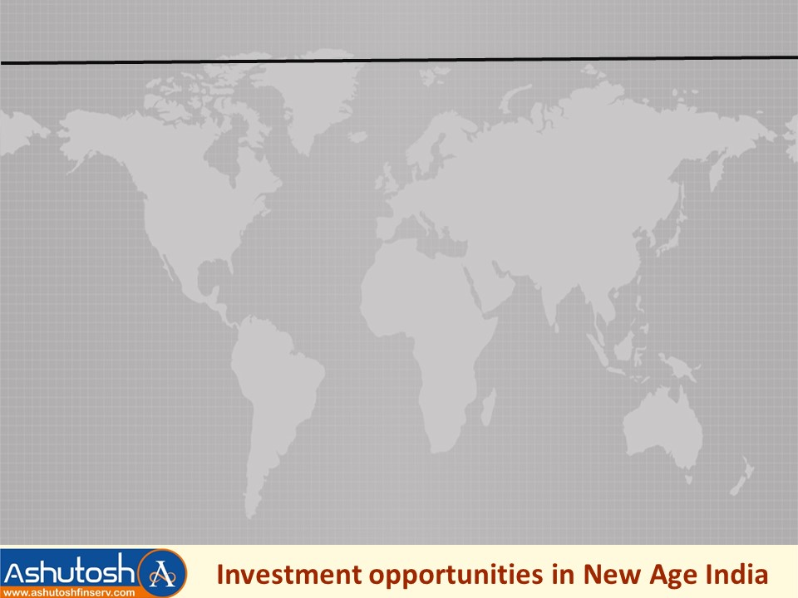
Tax Free Equity Investments via emerging hub of GIFT City
Invest in Alternative Investment Funds (AIFs) registered in GIFT City from Singapore.
The AIFs will invest in Indian Mutual Funds which invest into the equity shares.
The funds with the gains can be repatriated back to Singapore seamlessly.
The gains on sale of the units of the AIF will be tax free to the investor
Advantages:
1. USD denominated investments with basic KYC without any hassles.
2. No requirement of any demat account or bank account in India.
3. No tax implications on the transactions in India since routed through GIFT City.

Slide 19
Building an efficient Equity Mutual Funds Portfolio in India
Widely accepted as the most simple, convenient and cost effective means of investment in the Equity Market in India.
Investors often invest in schemes on random basis and often participate in NFO (New Fund Offer) of Mutual Funds.
Well designed portfolio basis investor financial profile, risk appetite and financial goals.
Mutual Fund schemes with appropriate distribution across various categories (Large & Mid, Flexicap, Multicap, Midcap, Smallcap, Value, Thematic/Sectoral funds, Foreign Funds, etc.)
AMC (Asset Management Company) concentration, quartile performance and benchmark comparison.

Slide 20
Tax free investing in India through Mutual Funds
Investment in Indian Mutual Funds (Equity or Non-Equity) by Singapore Tax Residents*
Sale of investments subject to TDS (Tax Deduction at Source)/
Withholding tax
Obtaining TRC (Tax Residency Certificate) in Singapore from IRAS for that tax year
Submit Form 10F to Indian Income Tax Dept. to claim the exemption.
Obtain refund of the taxes deducted on the Mutual Fund capital gains (short term or long term)
File Income Tax Return in India and claim benefit under Article 13 of India-Singapore DTAA
*Singapore Citizens or Singapore Permanent Resident (SPR) or persons who have stayed predominantly in Singapore in previous calendar year
This interpretation of the DTAA has been confirmed by the following judicial decisions:
1. ITO (IT) 2(1) Mumbai vs. Shri Satish Beharilal Raheja ITA NO.4627/Mum/2009
2. The Dy. Commissioner of Income-tax (International Taxation) Kochi vs. Sri.K.E.Faizal ITA No.423/Coch/2018

Slide 21
Investment in Portfolio Management Service (PMS)
Investment in a concentrated portfolio of Equity Shares.
Choice of portfolio strategy with the fund manager is available as per specific needs.
Limited regulatory restrictions on fund management – Hence concentrated portfolio with diversification of equity shares.
PMS portfolio not impacted by inflow & outflow of other investors.
Minimum investment size Rs. 50,00,000/-.

Slide 22
Investment in Unlisted/Pre-IPO equity shares
and Promising Startups
Why should we invest into such investment options?
“CATCH THEM YOUNG” - early mover advantage.
The returns on such stock would be multi-bagger.
When the come for IPO the success story is evident & visible to the world at large.

Slide 23
Investment in Unlisted Equity Shares
Parameters for stock selection when investment directly in specific stock
Promoter.
Track Record.
Business activity – Futuristic.
MOAT – Competitive advantage available.
Possibility of value unlocking – chances of going for IPO.
Comfort in longer holding period – For delay in IPO.

Slide 24
Investment in Unlisted Equity Shares
Case Study: Success story of unlisted stocks of
Tata Technologies Ltd.
7x in 3 years – 88% CAGR return on investment!!!
Activity | Month | No. of shares | Price | Amount
Investment | Feb 2021 | 1 | 1575/- | 1575/-
Pre-Bonus/Split | Dec 2022 | 1 | 7119/- | 7119/-
Bonus (1:1) | Jan 2023 | 2 | 814/- | 1628/-
Split (5:1) | Jan 2023 | 10 | 814/- | 8140/-
IPO price | Nov 2023 | 10 | 500/- | 5000/-
Current price | 15th March 24 | 10 | 1046/- | 10460/-

Slide 25
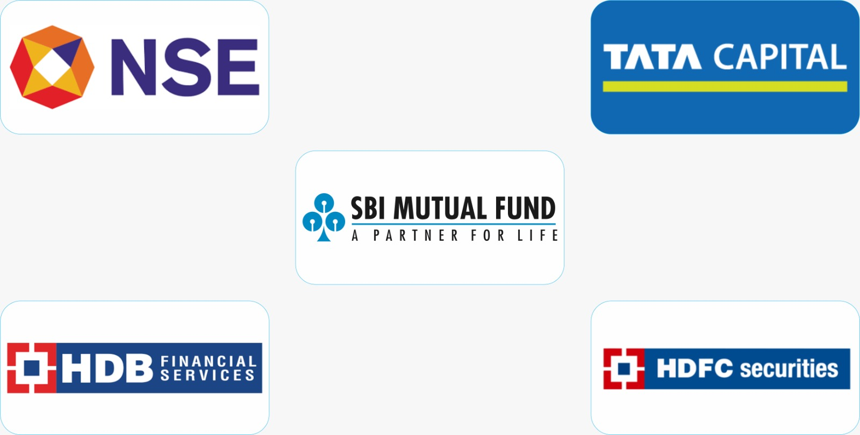
Investment in Unlisted Equity Shares
Stocks of top Indian unlisted companies with bright future available
Seek complete details from us for investing in these companies

Slide 26
Investment in Unlisted Equity Shares
Challenges for investment in promising startups
Which unlisted companies/startups to invest in?
Their business, future, promoters, chances of IPO, etc.
What price to pay for unlisted stocks/startups?
Comparison with Indian & Global peers, adopting well analyzed valuation model.

Slide 27
Investment through Alternative Investment Funds (AIFs)
Structured way of investment into Unlisted Stocks.
Investment by highly experienced Fund Managers connected with industry.
Finding promising investment ideas available at attractive valuations.
AIF managed by institution of high repute.
Minimum investment size is Rs. 1 Cr payable normally in tranches.
Investment period could be 5 + 1 + 1 years.
AIFs for listed stocks - Taxation & Compliance of gains from sale of securities is the responsibility of the AIF and not the investor - same as a Mutual Fund.
The gains on listed stocks AIF are not taxable in the hands of the investor since they are taxed at the fund level.

Slide 28
Indian Investments Summary
Investment Vehicle​ | Minimum Ticket Size​ | Liquidity​ | Bank account & Demat account requirement​ | Recommended Time Horizon​
Mutual Funds​ | 8 SGD ​/ INR 500​ | High​ | NRE / NRO Bank account ​ | 5 years +​
PMS​ | 80K SGD / ​ INR 50 lakhs​ | Moderate​ | NRE PIS Demat / NRO Demat Account + NRE / NRO Bank Account​ | 5 years +​
Pre-IPO/Unlisted Equity Shares | 1600 SGD /​ INR 1 lakh​ | Low-Moderate​​ | NRO Demat + NRO Bank account​ | ​7 years +
Unlisted Shares AIFs​ | 161K SGD /​ INR 1 CR​ | Low | ​NRE PIS Demat / NRO Demat Account + NRE / NRO Bank Account​ | ​7 years +
GIFT City AIFs​ | 161K SGD /​ INR 1 CR​ | Moderate -High​ | No requirements​ | ​5 years +

Slide 29
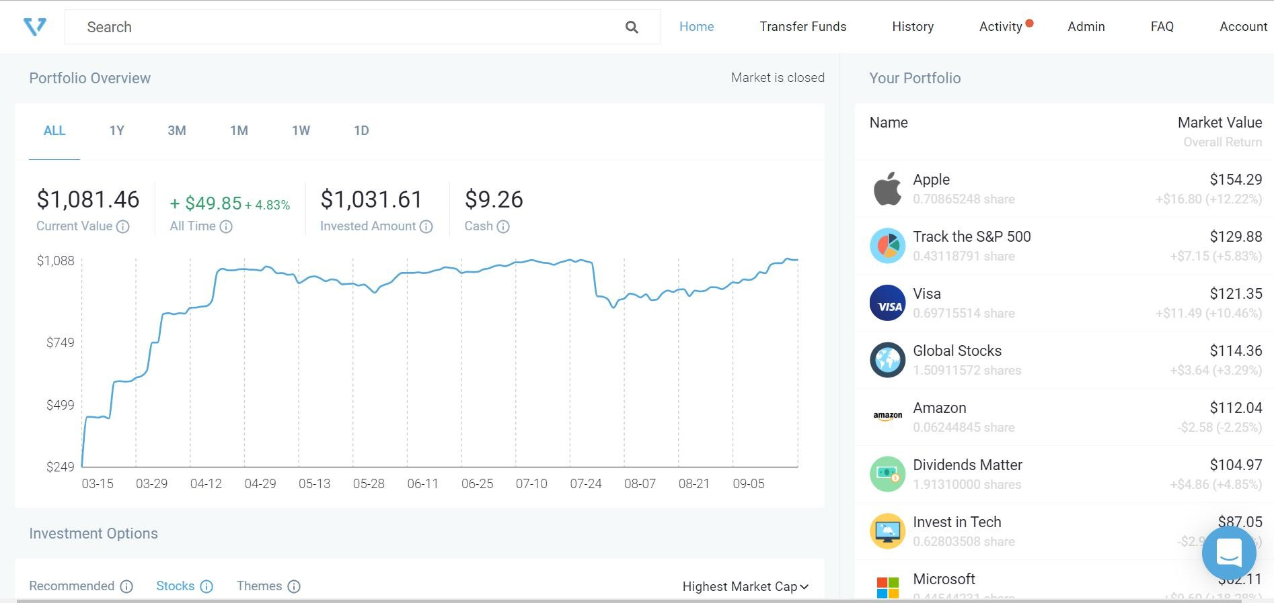
Process of investment in U.S. market
Investing in U.S.A. Stock Market – Global diversification
Enjoy simple and seamless online process to invest from Singapore in direct U.S.A. stocks/ETFs/stock portfolios
Visit our platform: ashutoshfinserv.vested.co.in
Broker partner is DriveWealth LLC and custodian is Citibank.
No brokerage/transaction charges/account opening charges –
Fixed fee of 1% p.a. (plus GST) on the total portfolio value
Funds to be remitted directly from Singapore to U.S.A. and vice versa.
No tax implications in India.

Slide 30
Snapshot of the user-friendly investing platform
Investing in U.S.A. Stock Market – Global diversification
USD fund transfer simplified
Directly access trade confirmations and monthly statements delivered by the broker
Hold funds as cash (earns up to 1% p.a.)
Invest in fractions
ETFs rebranded as easily digestible themes
Help is always around the corner!

Slide 31
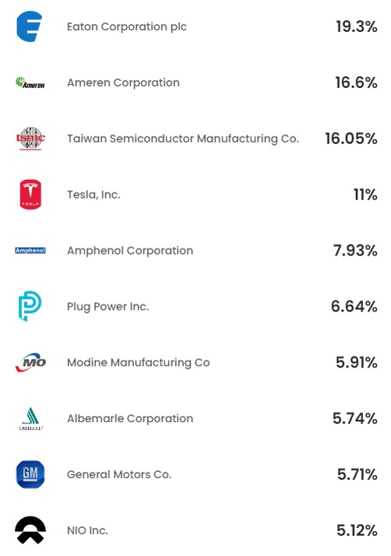
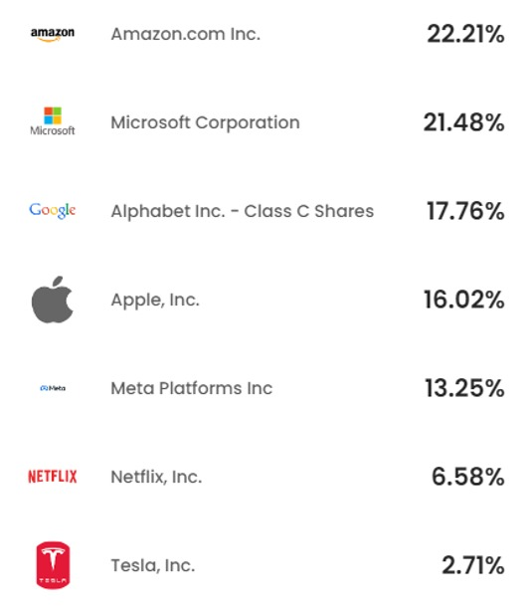
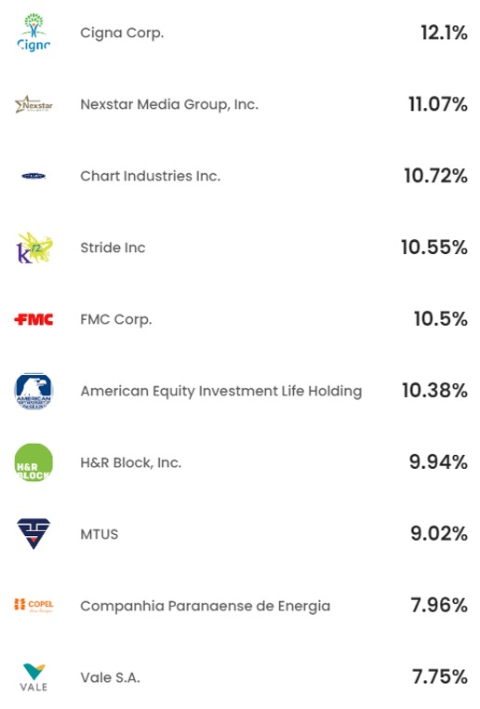
Investing in U.S.A. Stock Market – Global diversification
Portfolio - EV Tech
Portfolio – FAANGMT
Portfolio - FastMovers

Slide 32
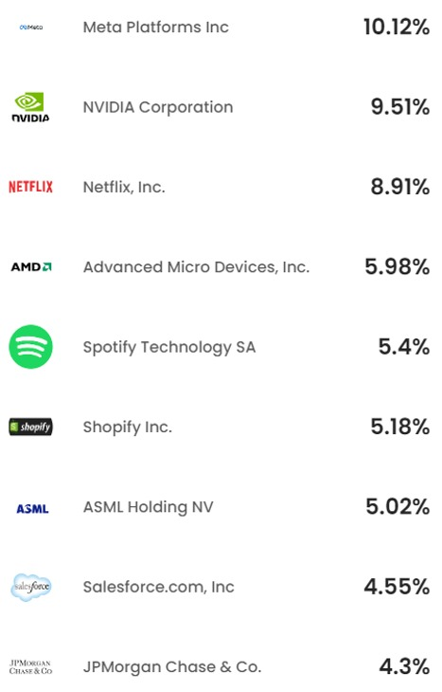
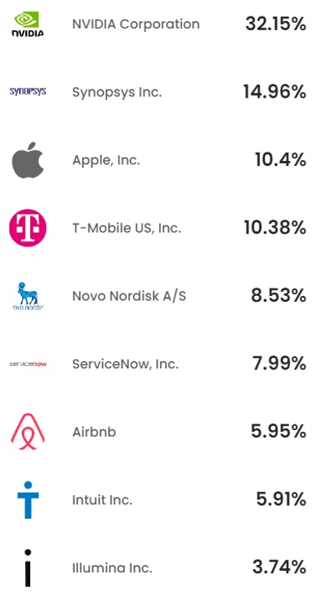
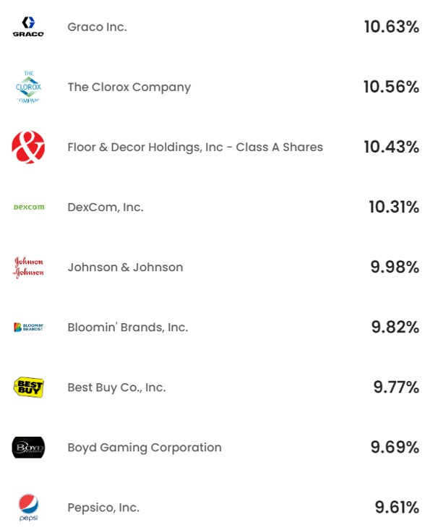
Investing in U.S.A. Stock Market – Global diversification
Portfolio - MOAT
Portfolio - FocusedTech
Portfolio – Hidden Gems

Slide 33
How can NRIs manage repatriation of funds seamlessly?
Repatriation for NRI - Summary
Type of investment | Origin of fund | Mode of repatriation to Singapore
1. Mutual Funds/PMS/Listed Equity Shares/AIFs | NRE Bank account | Direct international bank transfer
 | NRO Bank account | Transfer process under the US$1 million scheme
2. Real Estate property | NRO/NRE Bank account | Transfer process under the US$1 million scheme
3. Unlisted/Pre-IPO shares | NRO/NRE Bank account | Transfer process under the US$1 million scheme

Slide 34
Real Estate investment for NRI in India
Real estate investment may go for significant time correction which could subside the long term returns.
Liquidity and management of Real Estate continues to be a challenge.
Process of investment, disinvestment and remittance of proceeds requires efforts and time.
Next generation of most NRIs is not keen to relocate to India and manage the immovable properties.
Real Estate for self use of NRI planning or may be required to relocate to India on need basis.
Hence, Real Estate is not a preferred route of investment vis-à-vis financial assets for NRI.

Slide 35


About us….
65+ year legacy – One stop solution for all financial needs of an NRI in India.
Active office presence at Mumbai, Ahmedabad & Rajkot locations.
NRI Services representatives across the globe with a team strength of 60+ in India.
Serving 3500+ families from India and across the globe from 20+ countries.
Dedicated NRI team of client relationship managers for all financial services requirements.
Managing financial assets > INR 700 Crores in Indian as well as Global financial markets.

Slide 36

Our upcoming corporate house in India
Do visit us personally at Mumbai, Ahmedabad or Rajkot…..

Slide 37
About us….
Representatives in Singapore
Ms. Ayushi Kothari
M. Com., CA Inter, 8+ years experience in SG Financial System.
Mr. Deepesh Kothari
10+ Years experience as a Marketing professional in SG Corporate System.
Contact number - +65 8141 1632
Second Webinar of the series on the 6th of April, 2024
Feedback for your topics of interest….

Slide 38
Disclaimer
This Presentation contains personal views of the Speakers Mr. Daxesh Kothari & CA. Rajit Kothari on the respective subjects. The speakers and the company Ashutosh Financial Services P. Ltd. does not purport give any professional investment advice. Financial Products are subject to related risks and one should read the offer documents carefully before acting on it.
This Presentation may contain references, wherever possible, website links, regulations or other policy materials. The information provided, is only intended to be a general summary. All information in this presentation, including charts, examples and other website references, may be used for any purpose only after appropriate professional advice.
Investment opportunities in New Age India

Slide 39

Thank you
Questions ?
Investment opportunities in New Age India

